Slide 1
Summary of MAC protocols
What do you do with a shared media?
  Channel Partitioning, by time, frequency or code
    Time Division,Code Division, Frequency Division
  Random partitioning (dynamic),
    ALOHA, S-ALOHA, CSMA, CSMA/CD
    carrier sensing: easy in some technoligies (wire), hard in others (wireless)
    CSMA/CD used in Ethernet
  Taking Turns
    polling from a central cite, token passing
5: DataLink Layer
5a-<number>

Slide 2
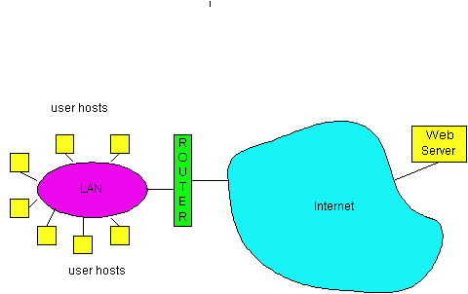
LAN technologies
Data link layer so far:
  services, error detection/correction, multiple access
Next: LAN technologies
  addressing
  Ethernet
  hubs, bridges, switches
  802.11
  PPP
  ATM
5: DataLink Layer
5a-<number>

Slide 3
LAN Addresses and ARP
32-bit IP address:
network-layer address
used to get datagram to destination network (recall IP network definition)
LAN (or MAC or physical) address:
used to get datagram from one interface to another physically-connected interface (same network)
48 bit MAC address (for most LANs)
burned in the adapter ROM
5: DataLink Layer
5a-<number>

Slide 4
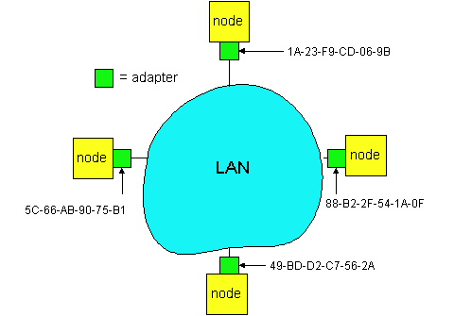
LAN Addresses and ARP
Each adapter on LAN has unique LAN address
5: DataLink Layer
5a-<number>

Slide 5
LAN Address (more)
MAC address allocation administered by IEEE
manufacturer buys portion of MAC address space (to assure uniqueness)
Analogy:
(a) MAC address: like Social Security Number
(b) IP address: like postal address
MAC flat address => portability
  can move LAN card from one LAN to another
IP hierarchical address NOT portable
  depends on network to which one attaches
5: DataLink Layer
5a-<number>

Slide 6

Recall earlier routing discussion
Starting at A, given IP datagram addressed to B:
look up net. address of B, find B on same net. as A
link layer send datagram to B inside link-layer frame
A
223.1.1.1
223.1.2.1
223.1.1.2
223.1.1.4
223.1.2.9
B
223.1.2.2
E
223.1.1.3
223.1.3.27
223.1.3.1
223.1.3.2
frame source,
dest address
datagram source,
dest address
B’s MAC
addr
A’s MAC
addr
A’s IP
addr
B’s IP
addr
IP payload
datagram
frame
5: DataLink Layer
5a-<number>

Slide 7
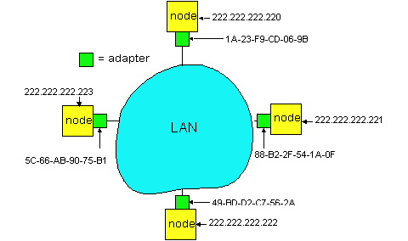
ARP: Address Resolution Protocol
Question: how to determine
MAC address of B
given B’s IP address?
Each IP node (Host, Router) on LAN has ARP module, table
ARP Table: IP/MAC address mappings for some LAN nodes
< IP address; MAC address; TTL>
< ………………………….. >
  TTL (Time To Live): time after which address mapping will be forgotten (typically 20 min)
5: DataLink Layer
5a-<number>

Slide 8
ARP protocol
A knows B's IP address, wants to learn physical address of B
A broadcasts ARP query pkt, containing B's IP address
  all machines on LAN receive ARP query
B receives ARP packet, replies to A with its (B's) physical layer address
A caches (saves) IP-to-physical address pairs until information becomes old (times out)
  soft state: information that times out (goes away) unless refreshed
5: DataLink Layer
5a-<number>

Slide 9
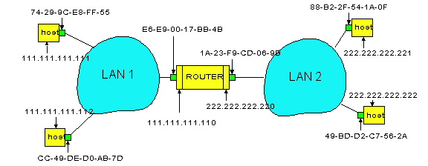
Routing to another LAN
walkthrough: routing from A to B via R
In routing table at source Host, find router 111.111.111.110
In ARP table at source, find MAC address E6-E9-00-17-BB-4B, etc
A
R
B
5: DataLink Layer
5a-<number>

Slide 10
A creates IP packet with source A, destination B
A uses ARP to get R’s physical layer address for 111.111.111.110
A creates Ethernet frame with R's physical address as dest, Ethernet frame contains A-to-B IP datagram
A’s data link layer sends Ethernet frame
R’s data link layer receives Ethernet frame
R removes IP datagram from Ethernet frame, sees its destined to B
R uses ARP to get B’s physical layer address
R creates frame containing A-to-B IP datagram sends to B
A
R
B
5: DataLink Layer
5a-<number>

Slide 11

Ethernet
“dominant” LAN technology:
cheap $5 for 100Mbs!
first wildey used LAN technology
Simpler, cheaper than token LANs and ATM
Kept up with speed race: 10, 100, 1000 Mbps
Metcalfe’s Etheret
sketch
5: DataLink Layer
5a-<number>

Slide 12

Ethernet Frame Structure
Sending adapter encapsulates IP datagram (or other network layer protocol packet) in Ethernet frame
Preamble:
7 bytes with pattern 10101010 followed by one byte with pattern 10101011
used to synchronize receiver, sender clock rates
5: DataLink Layer
5a-<number>

Slide 13
Ethernet Frame Structure (more)
Addresses: 6 bytes, frame is received by all adapters on a LAN and dropped if address does not match
Type: indicates the higher layer protocol, mostly IP but others may be supported such as Novell IPX and AppleTalk)
CRC: checked at receiver, if error is detected, the frame is simply dropped
5: DataLink Layer
5a-<number>

Slide 14
Ethernet: uses CSMA/CD
A: sense channel, if idle
  then {
  transmit and monitor the channel;
      If detect another transmission
      then {
      abort and send jam signal;
        update # collisions;
        delay as required by exponential backoff algorithm;
        goto A
        }
      else {done with the frame; set collisions to zero}
    }
  else {wait until ongoing transmission is over and goto A}
5: DataLink Layer
5a-<number>

Slide 15
Ethernet’s CSMA/CD (more)
Jam Signal: make sure all other transmitters are aware of collision; 48 bits;
Exponential Backoff:
Goal: adapt retransmission attemtps to estimated current load
  heavy load: random wait will be longer
first collision: choose K from {0,1}; delay is K x 512 bit transmission times
after second collision: choose K from {0,1,2,3}…
after ten or more collisions, choose K from {0,1,2,3,4,…,1023}
5: DataLink Layer
5a-<number>

Slide 16
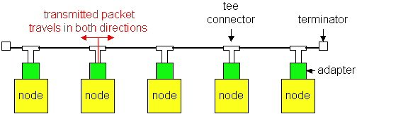
Ethernet Technologies: 10Base2
10: 10Mbps; 2: under 200 meters max cable length
thin coaxial cable in a bus topology
repeaters used to connect up to multiple segments
repeater repeats bits it hears on one interface to its other interfaces: physical layer device only!
5: DataLink Layer
5a-<number>

Slide 17
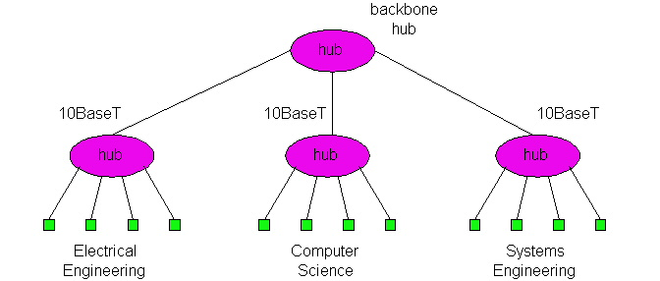
10BaseT and 100BaseT
10/100 Mbps rate; latter called “fast ethernet”
T stands for Twisted Pair
Hub to which nodes are connected by twisted pair, thus “star topology”
CSMA/CD implemented at hub
5: DataLink Layer
5a-<number>

Slide 18
10BaseT and 100BaseT (more)
Max distance from node to Hub is 100 meters
Hub can disconnect “jabbering adapter
Hub can gather monitoring information, statistics for display to LAN administrators
5: DataLink Layer
5a-<number>

Slide 19
Gbit Ethernet
use standard Ethernet frame format
allows for point-to-point links and shared broadcast channels
in shared mode, CSMA/CD is used; short distances between nodes to be efficient
uses hubs, called here “Buffered Distributors”
Full-Duplex at 1 Gbps for point-to-point links
5: DataLink Layer
5a-<number>

Slide 20
Interconnecting LANs
Q: Why not just one big LAN?
Limited amount of supportable traffic: on single LAN, all stations must share bandwidth
limited length: 802.3 specifies maximum cable length
large “collision domain” (can collide with many stations)
limited number of stations: 802.5 have token passing delays at each station
5: DataLink Layer
5a-<number>

Slide 21
Hubs
Physical Layer devices: essentially repeaters operating at bit levels: repeat received bits on one interface to all other interfaces
Hubs can be arranged in a hierarchy (or multi-tier design), with backbone hub at its top
5: DataLink Layer
5a-<number>

Slide 22
Hubs (more)
Each connected LAN referred to as LAN segment
Hubs do not isolate collision domains: node may collide with any node residing at any segment in LAN
Hub Advantages:
  simple, inexpensive device
  Multi-tier provides graceful degradation: portions of the LAN continue to operate if one hub malfunctions
  extends maximum distance between node pairs (100m per Hub)
5: DataLink Layer
5a-<number>

Slide 23
Hub limitations
single collision domain results in no increase in max throughput
  multi-tier throughput same as single segment throughput
individual LAN restrictions pose limits on number of nodes in same collision domain and on total allowed geographical coverage
cannot connect different Ethernet types (e.g., 10BaseT and 100baseT)
5: DataLink Layer
5a-<number>

Slide 24
Bridges
Link Layer devices: operate on Ethernet frames, examining frame header and selectively forwarding frame based on its destination
Bridge isolates collision domains since it buffers frames
When frame is to be forwarded on segment, bridge uses CSMA/CD to access segment and transmit
5: DataLink Layer
5a-<number>

Slide 25
Bridges (more)
Bridge advantages:
  Isolates collision domains resulting in higher total max throughput, and does not limit the number of nodes nor geographical coverage
  Can connect different type Ethernet since it is a store and forward device
  Transparent: no need for any change to hosts LAN adapters
5: DataLink Layer
5a-<number>

Slide 26
Bridges: frame filtering, forwarding
bridges filter packets
  same-LAN -segment frames not forwarded onto other LAN segments
forwarding:
  how to know which LAN segment on which to forward frame?
  looks like a routing problem (more shortly!)
5: DataLink Layer
5a-<number>

Slide 27
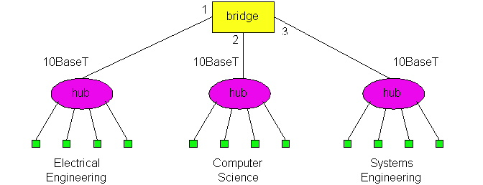
Backbone Bridge
5: DataLink Layer
5a-<number>

Slide 28
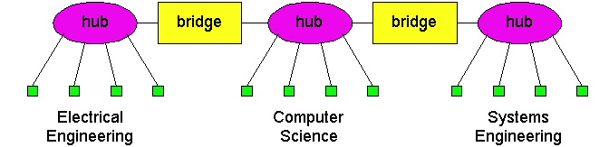
Interconnection Without Backbone
Not recommended for two reasons:
  - single point of failure at Computer Science hub
  - all traffic between EE and SE must path over CS segment
5: DataLink Layer
5a-<number>

Slide 29
Bridge Filtering
bridges learn which hosts can be reached through which interfaces: maintain filtering tables
  when frame received, bridge “learns” location of sender: incoming LAN segment
  records sender location in filtering table
filtering table entry:
  (Node LAN Address, Bridge Interface, Time Stamp)
  stale entries in Filtering Table dropped (TTL can be 60 minutes)
5: DataLink Layer
5a-<number>

Slide 30
Bridge Filtering
filtering procedure:
  if destination is on LAN on which frame was received
    then drop the frame
    else { lookup filtering table
    if entry found for destination
        then forward the frame on interface indicated;
        else flood; /* forward on all but the interface on which the frame arrived*/
      }
5: DataLink Layer
5a-<number>

Slide 31
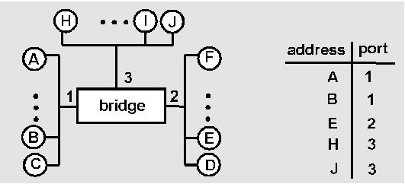
Bridge Learning: example
Suppose C sends frame to D and D replies back with frame to C
C sends frame, bridge has no info about D, so floods to both LANs
  bridge notes that C is on port 1
  frame ignored on upper LAN
  frame received by D
5: DataLink Layer
5a-<number>

Slide 32
Bridge Learning: example
D generates reply to C, sends
  bridge sees frame from D
  bridge notes that D is on interface 2
  bridge knows C on interface 1, so selectively forwards frame out via interface 1
5: DataLink Layer
5a-<number>

Slide 33
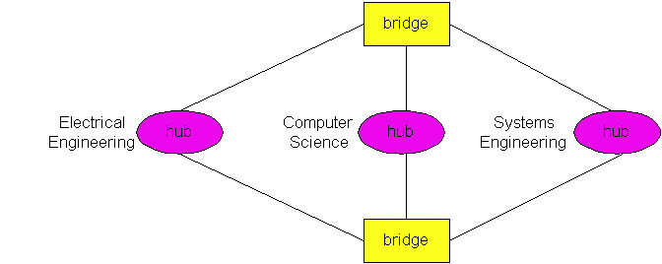
Bridges Spanning Tree
for increased reliability, desirable to have redundant, alternate paths from source to dest
with multiple simultaneous paths, cycles result - bridges may multiply and forward frame forever
solution: organize bridges in a spanning tree by disabling subset of interfaces
Disabled
5: DataLink Layer
5a-<number>

Slide 34

WWF Bridges vs. Routers
both store-and-forward devices
  routers: network layer devices (examine network layer headers)
  bridges are Link Layer devices
routers maintain routing tables, implement routing algorithms
bridges maintain filtering tables, implement filtering, learning and spanning tree algorithms
5: DataLink Layer
5a-<number>

Slide 35
Routers vs. Bridges
Bridges + and -
+ Bridge operation is simpler requiring less processing bandwidth
- Topologies are restricted with bridges: a spanning tree must be built to avoid cycles
- Bridges do not offer protection from broadcast storms (endless broadcasting by a host will be forwarded by a bridge)
5: DataLink Layer
5a-<number>

Slide 36
Routers vs. Bridges
Routers + and -
+ arbitrary topologies can be supported, cycling is limited by TTL counters (and good routing protocols)
+ provide firewall protection against broadcast storms
- require IP address configuration (not plug and play)
- require higher processing bandwidth
bridges do well in small (few hundred hosts) while routers used in large networks (thousands of hosts)
5: DataLink Layer
5a-<number>

